Slide 1

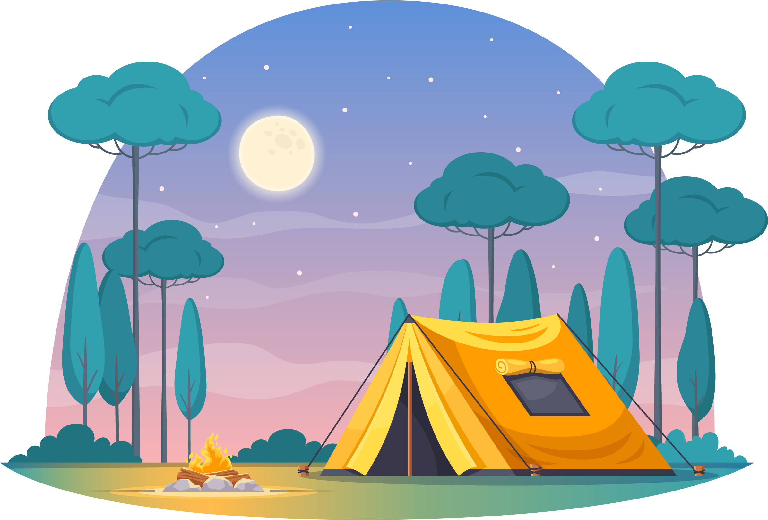
Campfire Safety
Notes:
Version 2022-11
Contact – QFES.CommunityEd@qfes.qld.gov.au

Slide 2

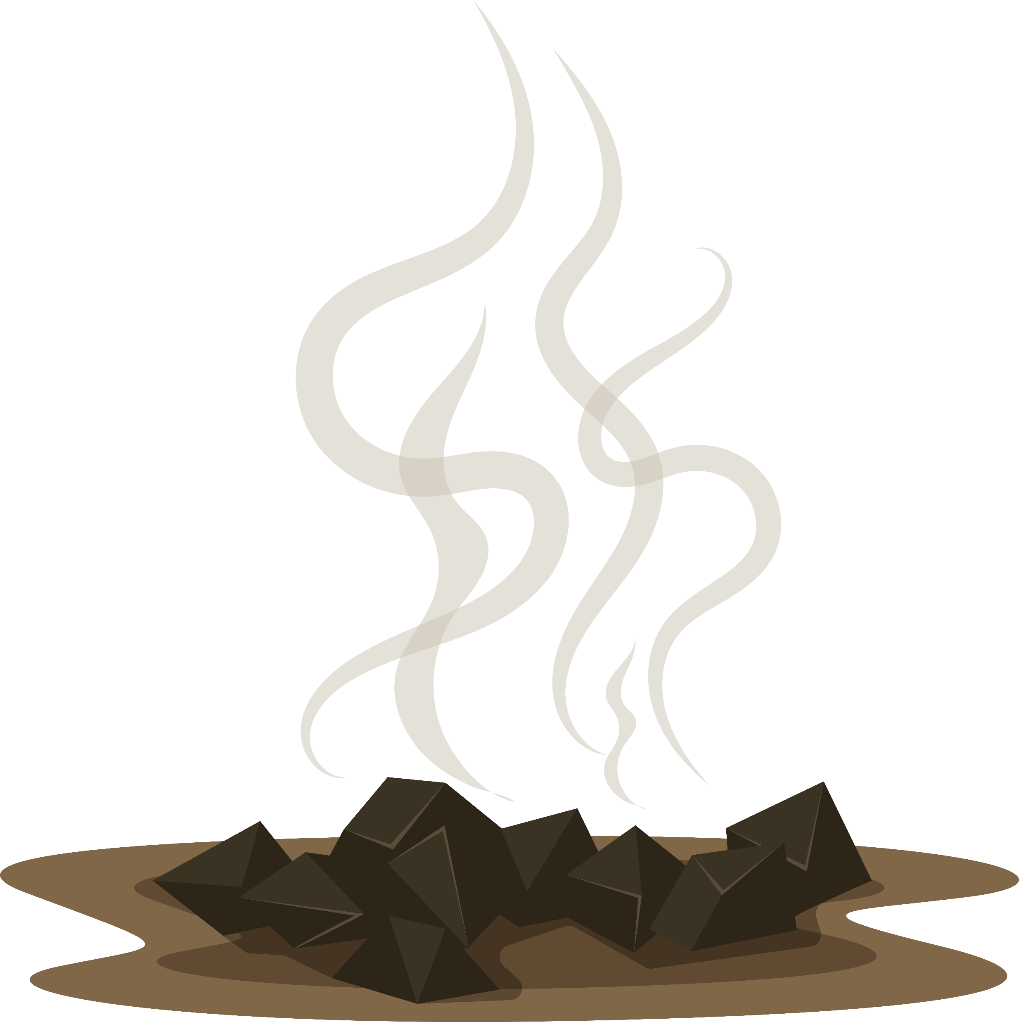
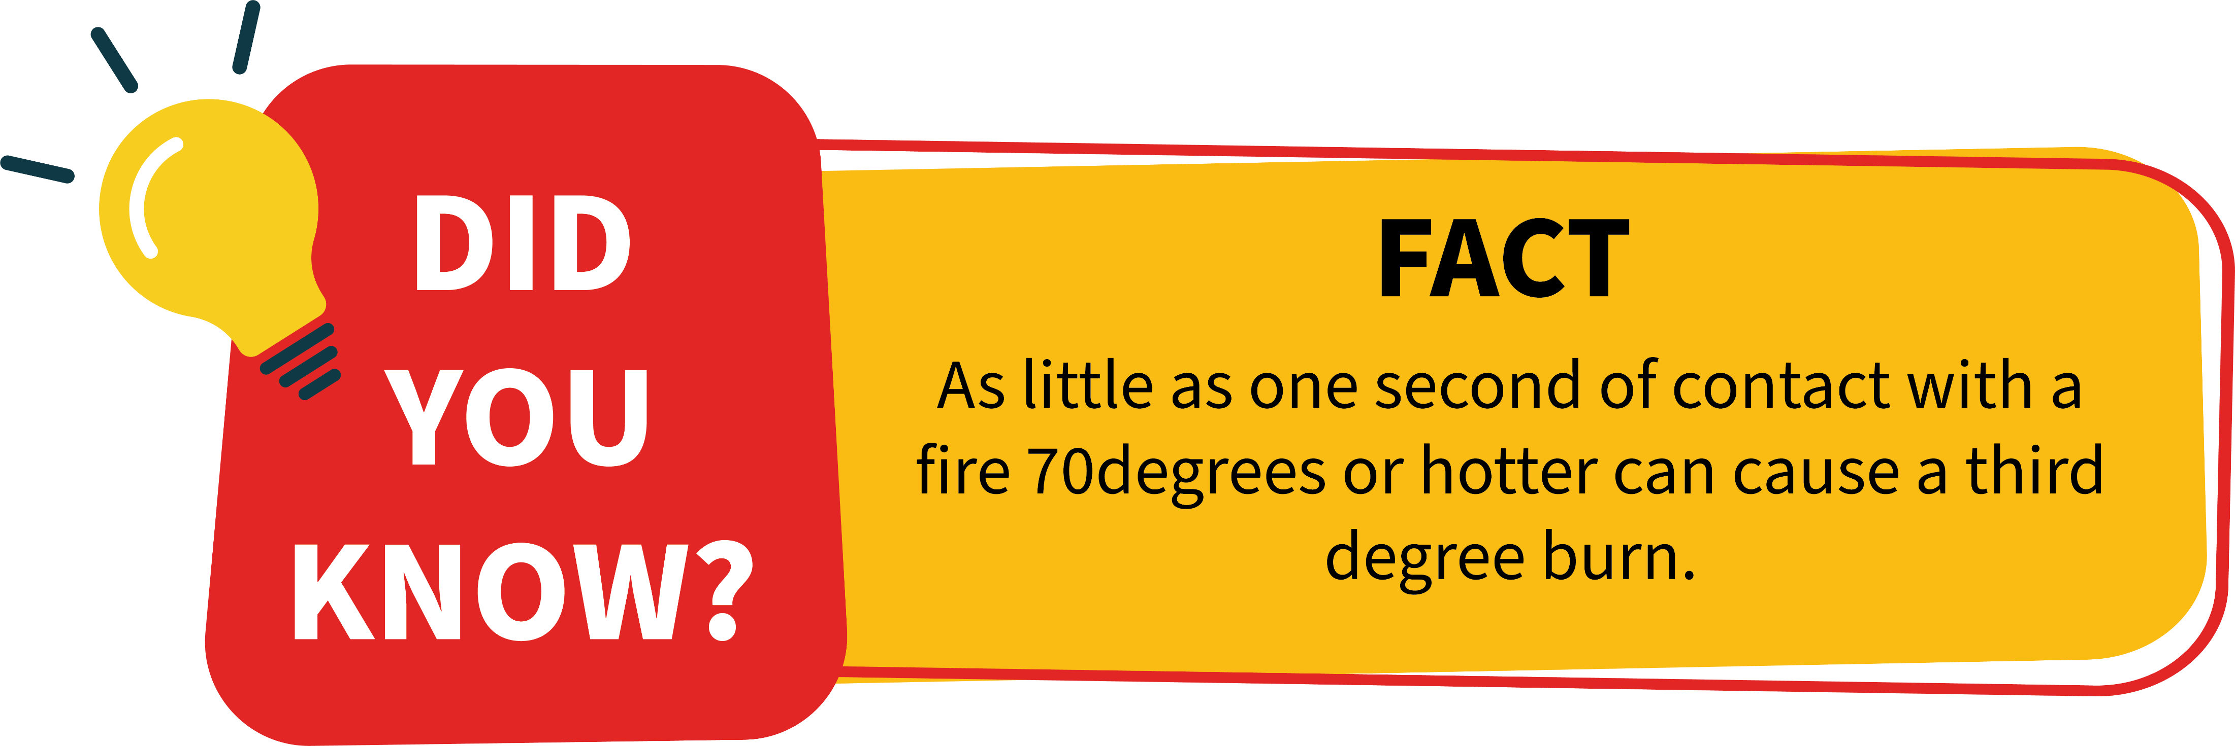
Campfires are the cause of 1/3 of burns to children’s feet and legs.
The majority of these burns were caused the morning after a fire. By contact with hot ashes and coals.

Slide 3
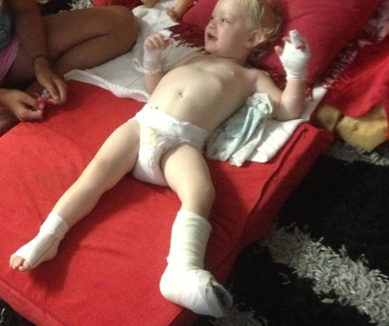
Campfires can cause serious injury
It can take months or even years of therapy to recover from burns to hands and feet. The scars can make moving difficult.

Slide 4
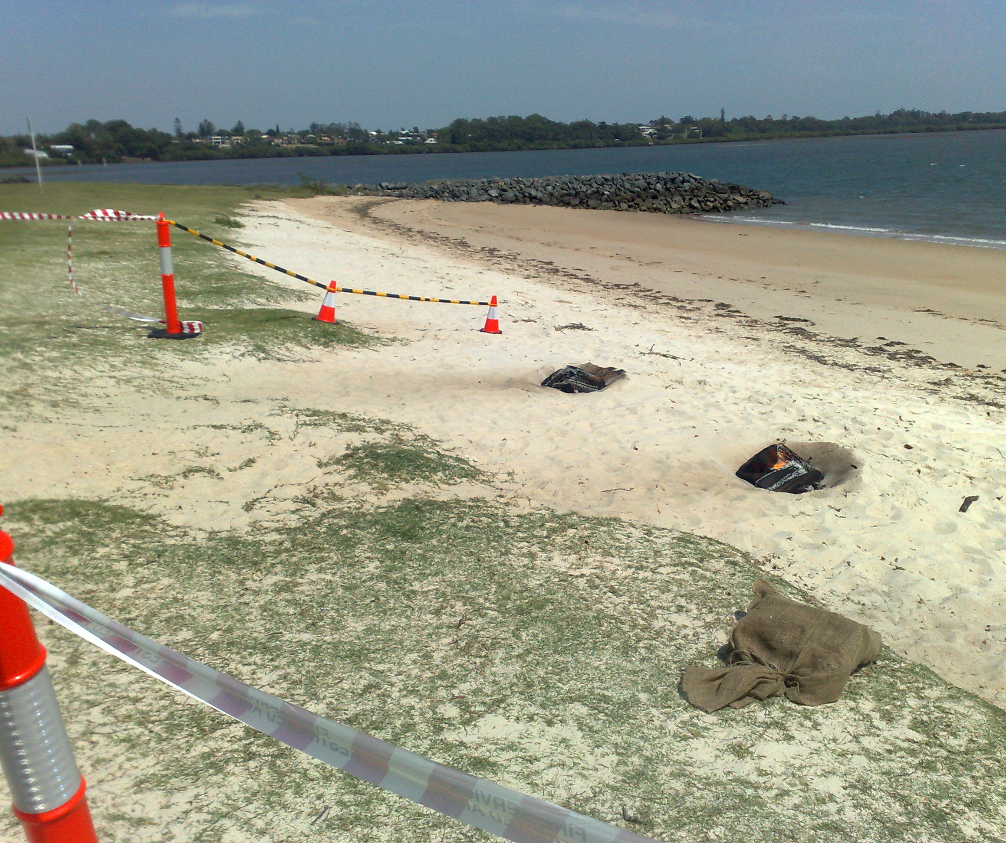
We ran a test!
Firefighters lit three campfires and let them burn for three hours.
They were hotter than 500 degrees.

Slide 5
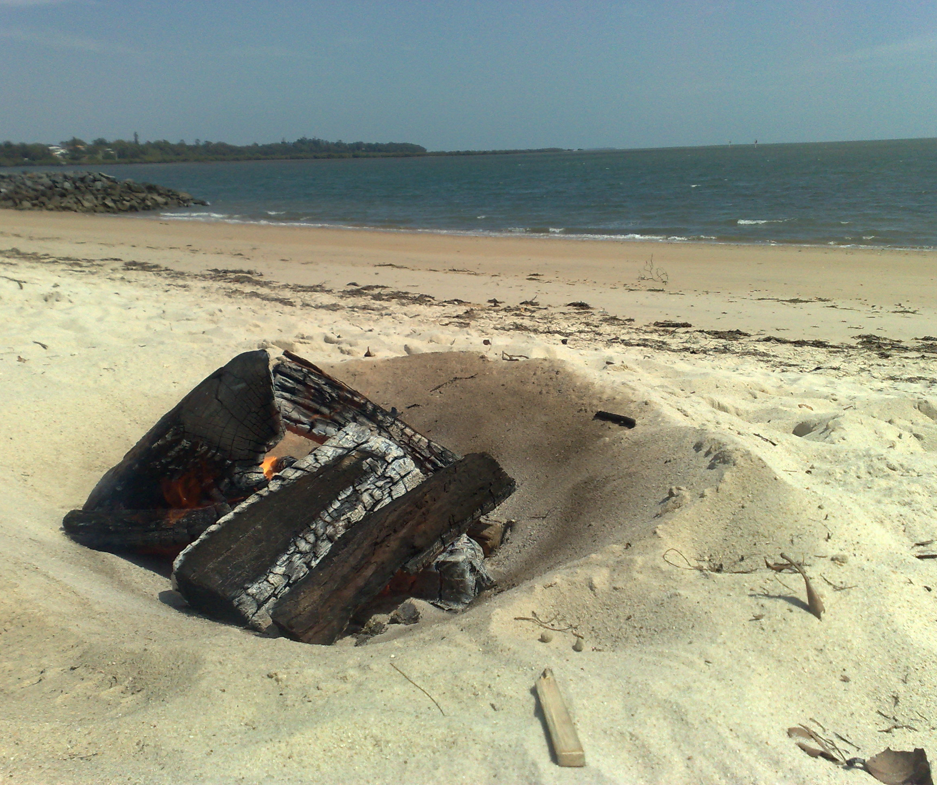
Self-extinguished
One fire was left to burn out. It was still over 100 degrees eight hours later. Hot enough to cause severe burns.
The campfire also spontaneously re-ignited.

Slide 6
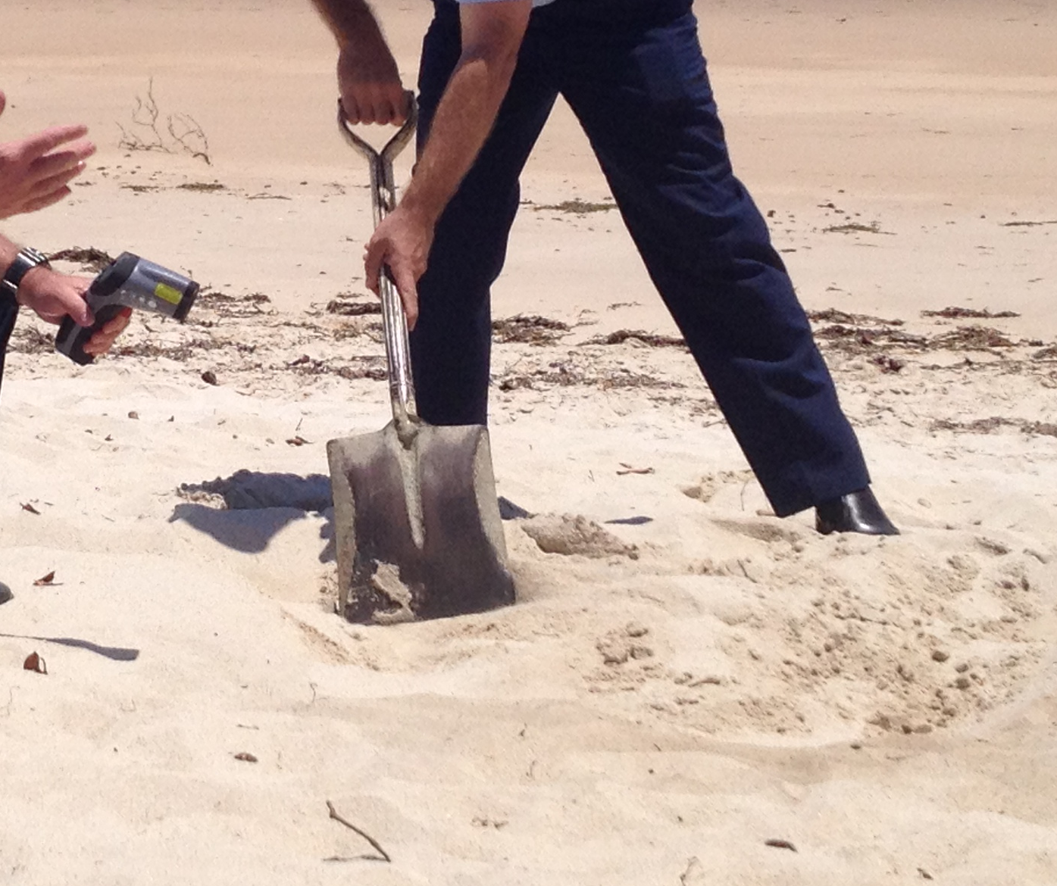
Covered with sand
The second campfire was put out by covering it with sand. It was still nearly 100 degrees eight hours later. Hot enough to cause serious burns.

Slide 7
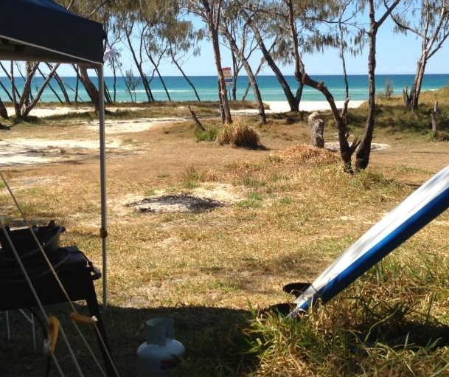
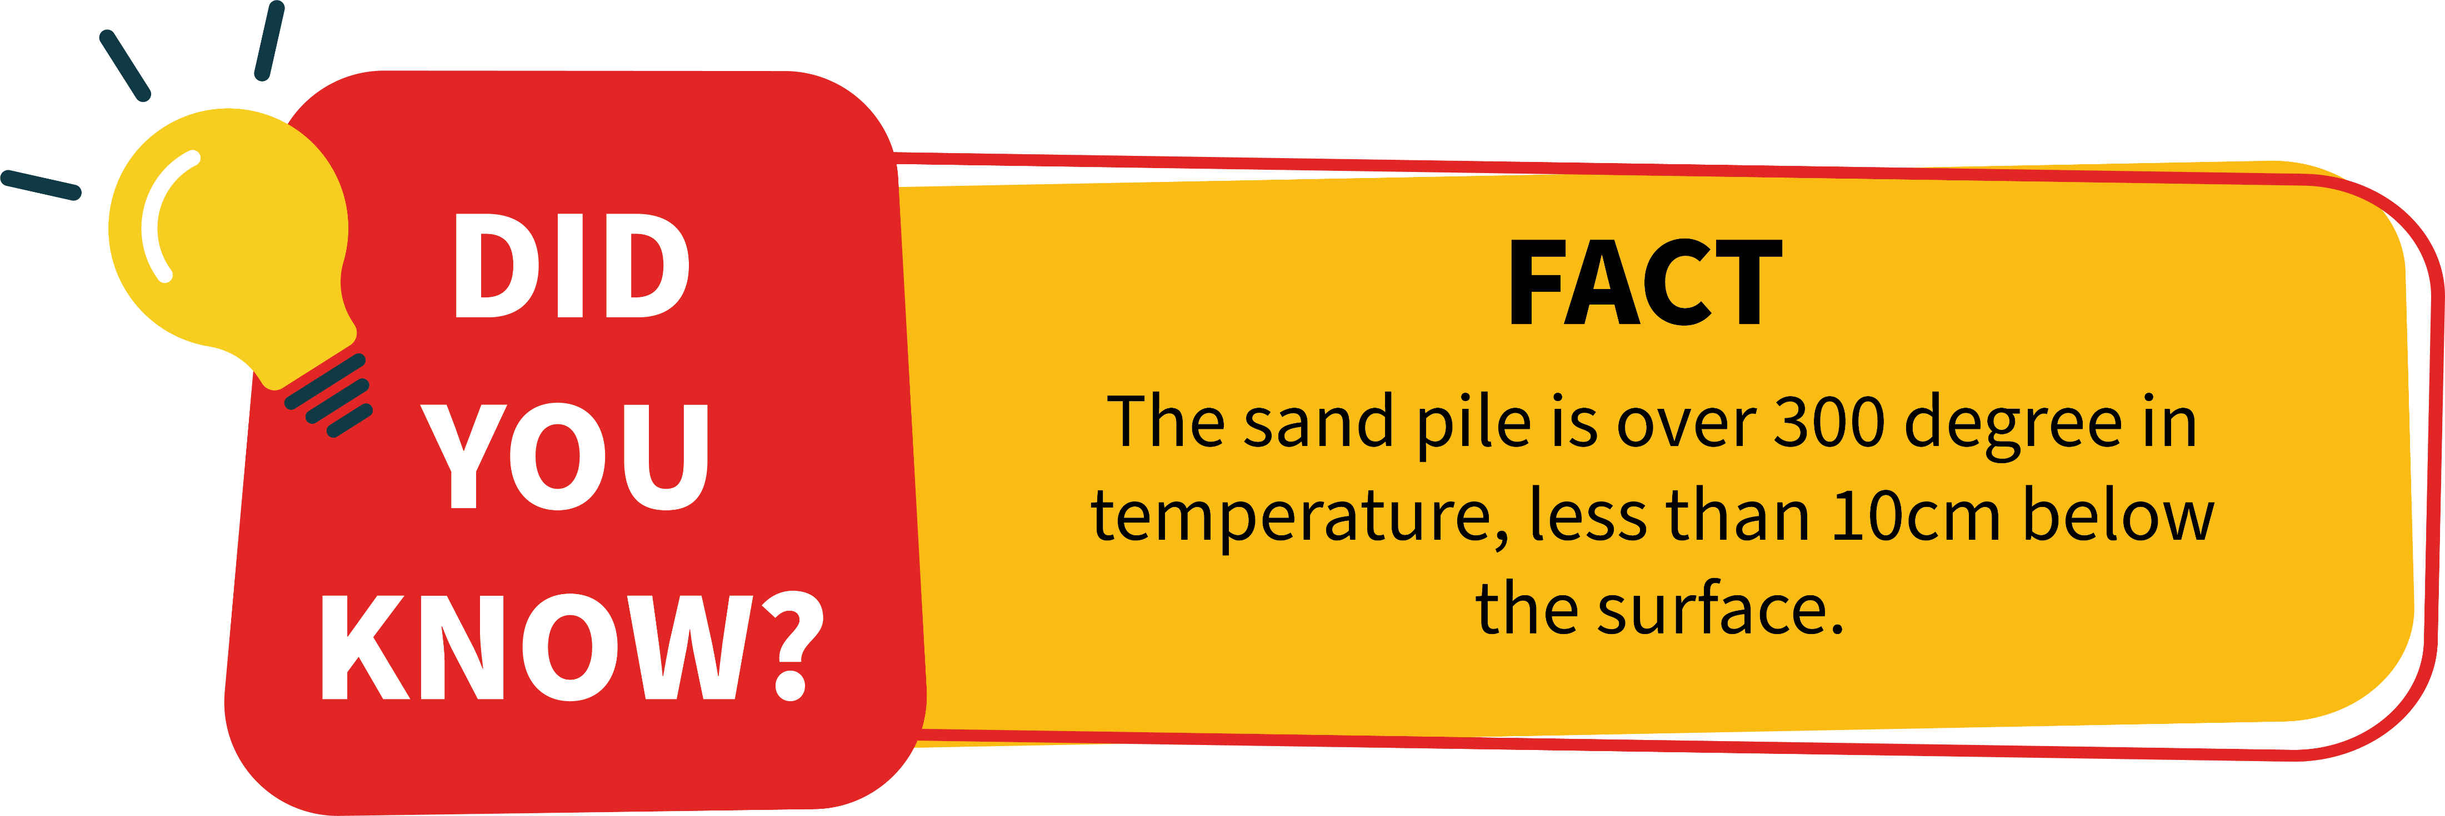
Campfires that are covered with sand stay hot for much longer. They are also disguised and can look like a sandpit to small children.

Slide 8
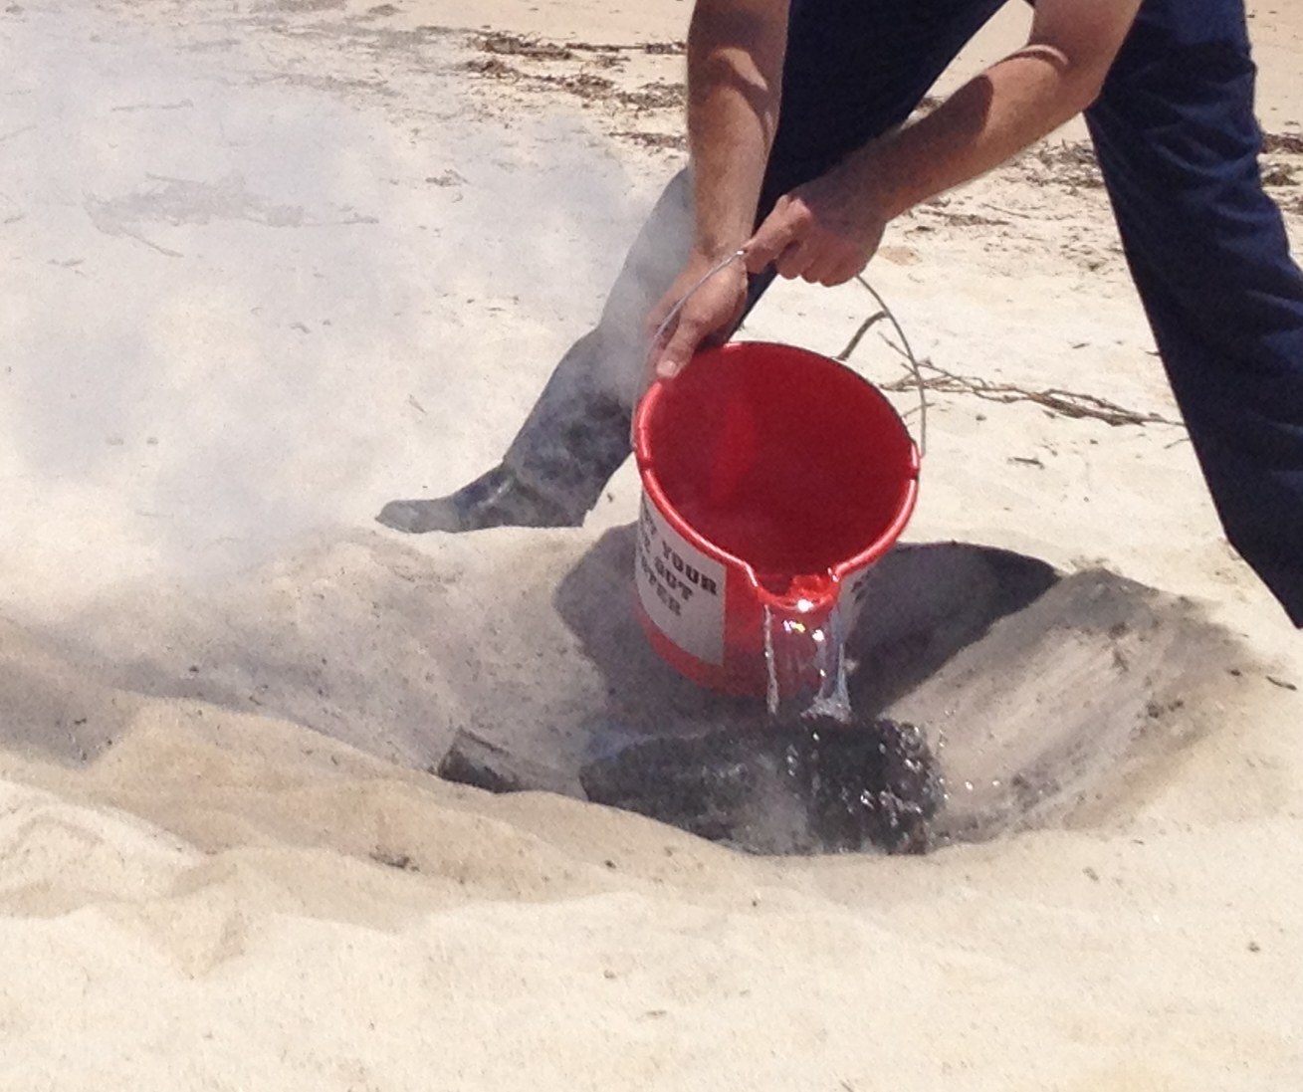
Put out with water
The third campfire was put out with water. It cooled to less than 50 degrees in only 10 minutes, and was about 10 degrees eight hours later.
These temperatures are unlikely to cause burns.

Slide 9
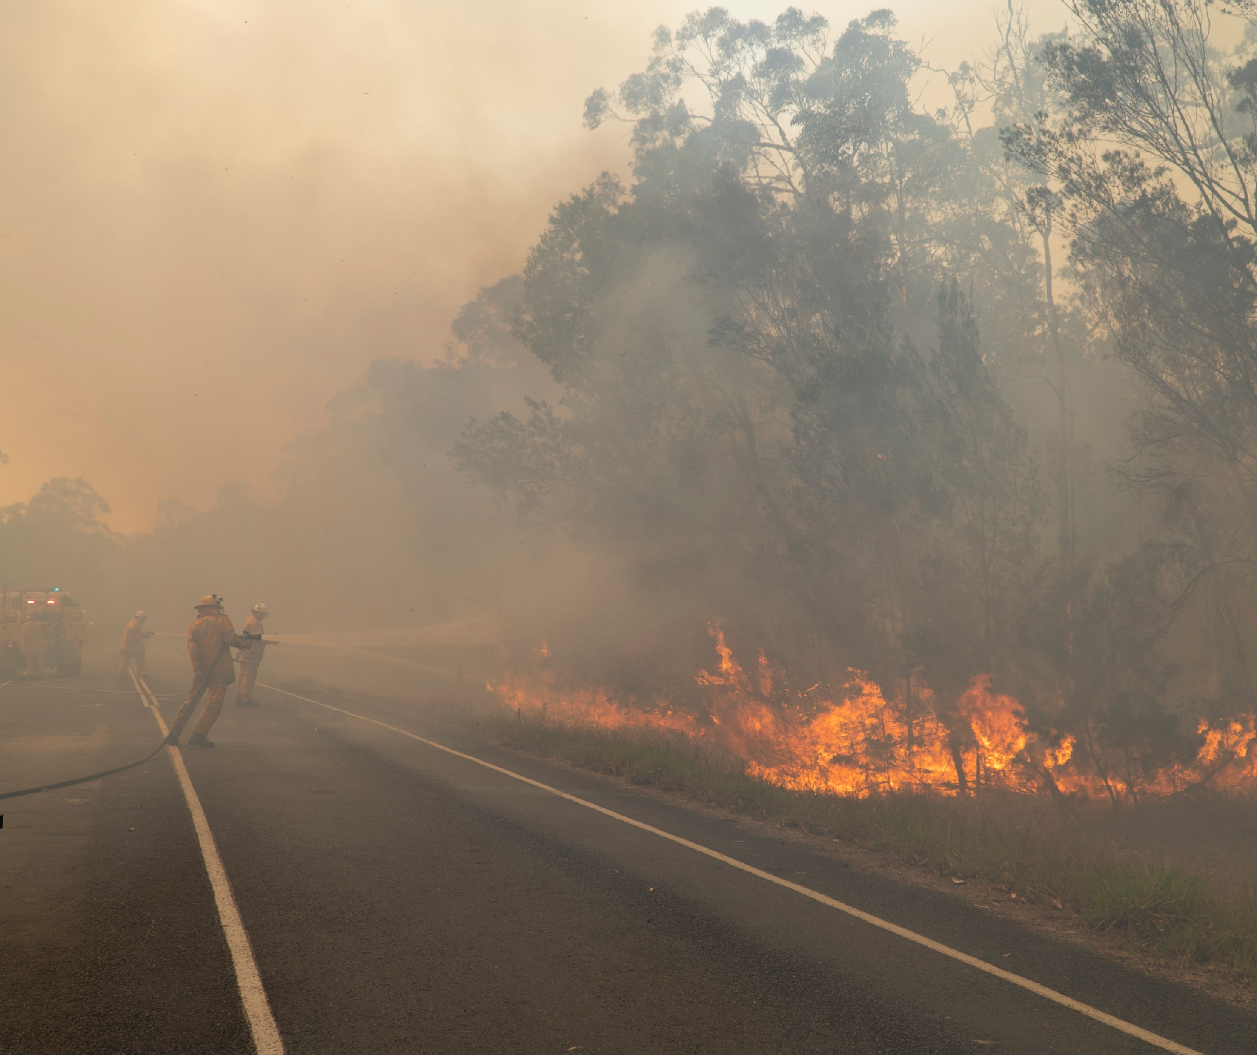
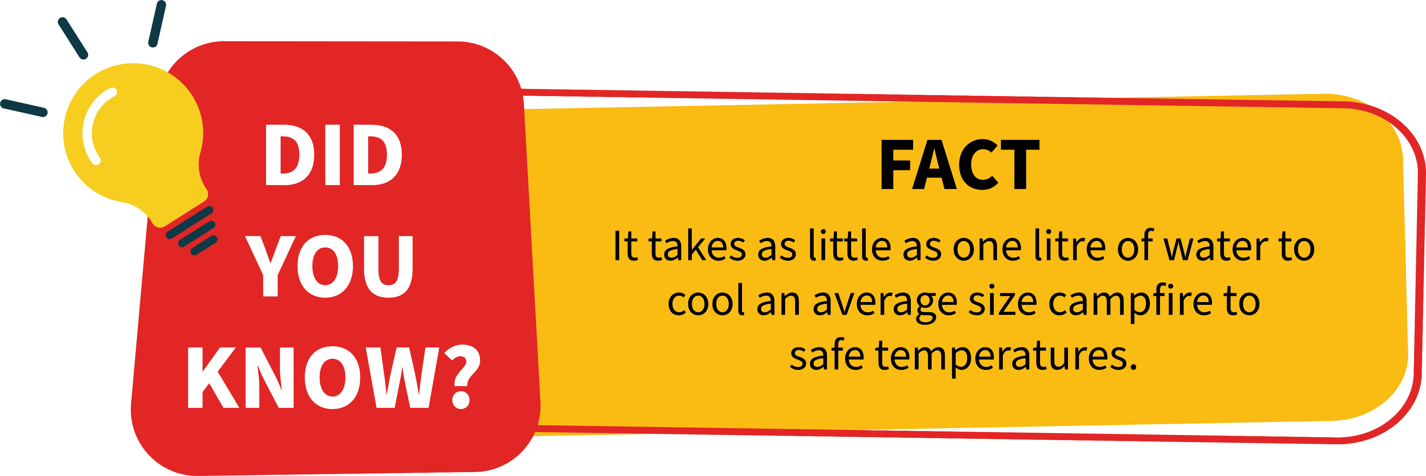
When you put your campfire out with water, you also reduce the risk of accidentally starting a grass fire or bushfire.

Slide 10
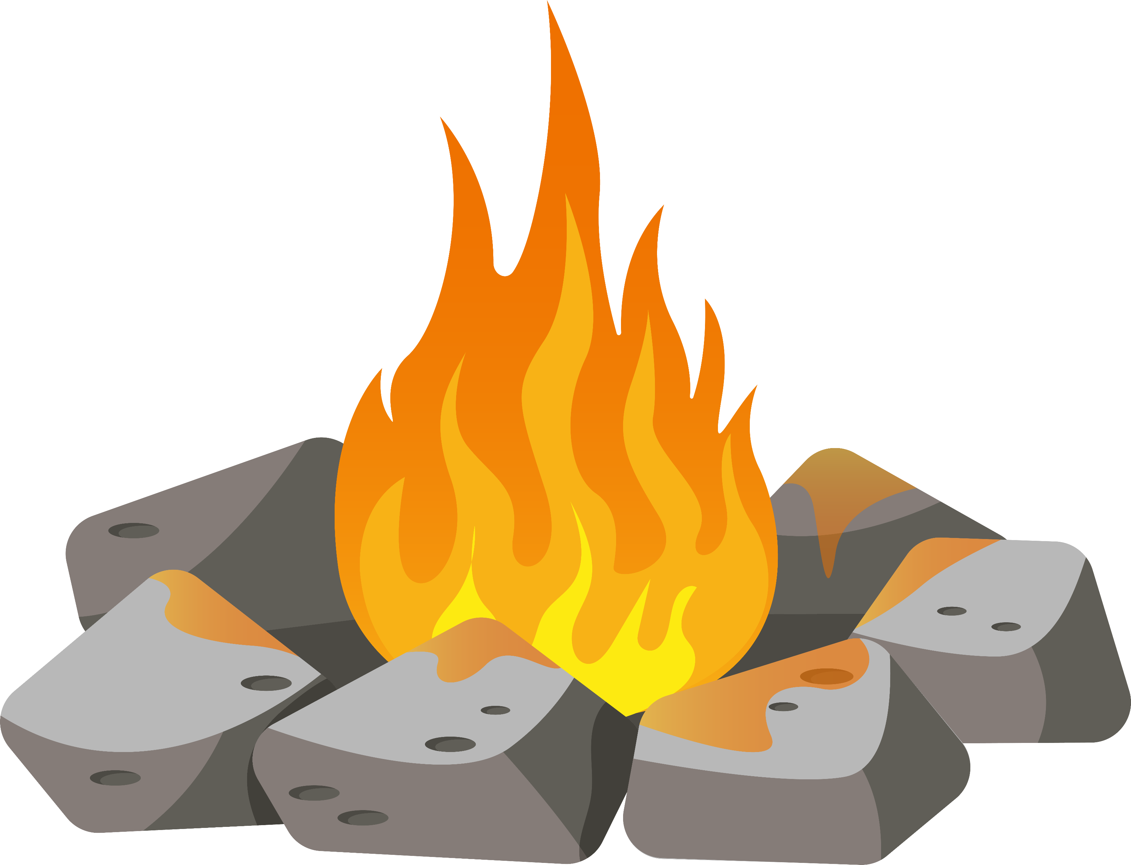
Every year firefighters respond to hundreds of fires that could have been easily prevented.
Before you light a fire:
Check for fire bans. Visit qfes.qld.gov.au to find out if there are bans in the area.
Check with council if a permit is need or if there are any local restrictions or instructions.

Slide 11
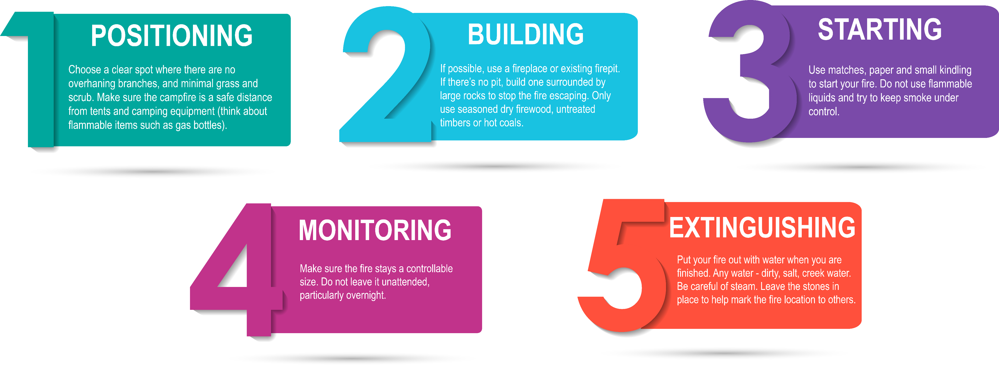
There are five basic rules for building a safe campfire.

Slide 14


Slide 16
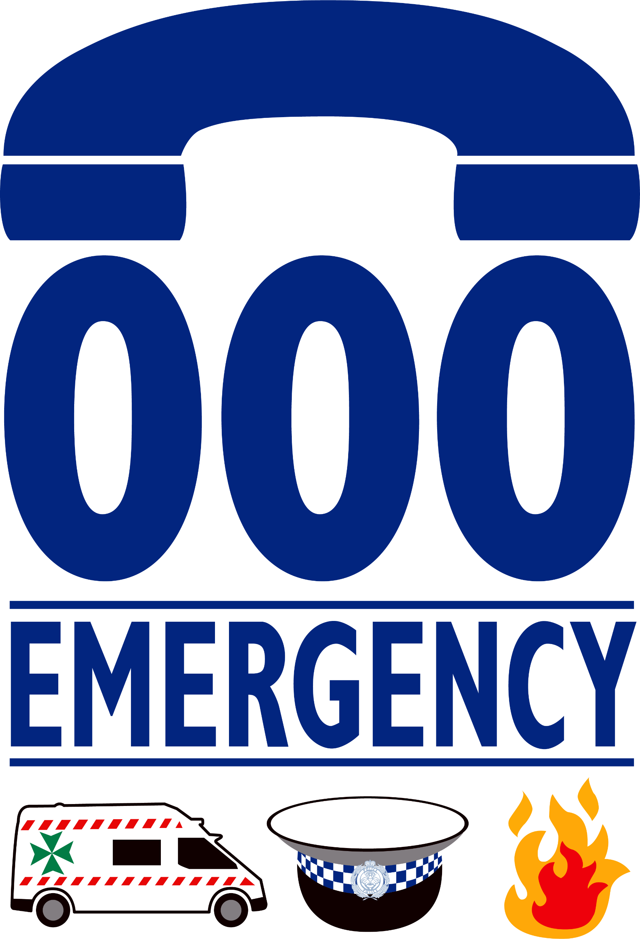
If your fire gets out of control or you see a bushfire or grassfire, report it immediately.
Call Triple Zero (000)

